Slide 1
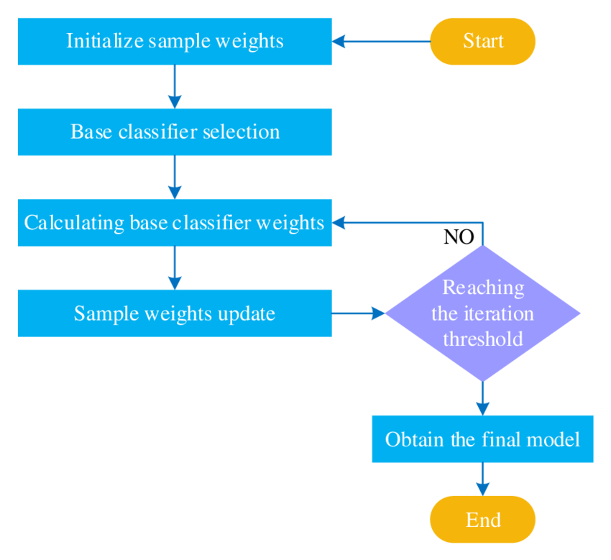
AdaBoost: The Powerful Ensemble Learning Algorithm
AdaBoost, short for Adaptive Boosting, is a popular ensemble learning algorithm that combines multiple weak models to create a strong, accurate predictor. It is particularly effective for classification tasks, leveraging the power of weak learners to achieve high-performance results.
by Praveen kumar T G

Slide 2
How AdaBoost Works
Step 1
Step 3
Train a weak learner (e.g., a simple decision tree) on the training data.
Train another weak learner, focusing more on the previously misclassified instances.
1
2
3
Step 2
Evaluate the performance of the weak learner and assign higher weights to misclassified instances.

Slide 3
Advantages of AdaBoost
1
Versatility
2
Robustness
AdaBoost can be used with a variety of weak learners, making it a flexible algorithm.
AdaBoost is resistant to overfitting and can handle noisy or complex data effectively.
3
Simplicity
4
High Performance
The AdaBoost algorithm is relatively straightforward to implement and understand.
By combining multiple weak learners, AdaBoost can achieve state-of-the-art classification accuracy.

Slide 4
Limitations of AdaBoost
Sensitivity to Outliers
Computational Complexity
Bias Towards Majority Class
AdaBoost can be sensitive to outliers in the training data, which can negatively impact the performance of the ensemble.
As the number of weak learners increases, the computational cost of training and evaluating the AdaBoost model can become high.
AdaBoost may struggle with imbalanced datasets, as it can be biased towards the majority class.

Slide 5




Applications of AdaBoost
Face Detection
Spam Filtering
Medical Diagnosis
Fraud Detection
AdaBoost has been successfully used for real-time face detection in images and video.
AdaBoost-based algorithms are commonly used in spam detection and email filtering.
AdaBoost is effective in identifying fraudulent activities in financial transactions and applications.
AdaBoost has been applied to various medical diagnosis tasks, such as disease classification.

Slide 6
Conclusion and Key Takeaways
In conclusion, AdaBoost is a powerful and versatile machine learning algorithm that has been widely adopted in various domains. By combining multiple weak learners into a strong classifier, AdaBoost can significantly improve the accuracy and robustness of predictions. Its adaptive nature, ability to handle diverse data types, and versatility in terms of the underlying weak learners make it a valuable tool in the machine learning practitioner's toolkit.
The key takeaways from this introduction to AdaBoost are:
AdaBoost is an ensemble method that combines multiple weak learners to create a strong, accurate classifier
It focuses on the most challenging instances, adaptively adjusting the weights of the training data to improve performance
AdaBoost offers advantages such as improved accuracy, robustness, and versatility, making it a popular choice for many real-world applications
While AdaBoost has its limitations, such as sensitivity to outliers and difficulty with imbalanced data, it remains a powerful and widely-used algorithm in the field of machine learning

